Slide 1
Akaike Information Criteria(AIC) and Schwarz Bayesian Information Criteria(BIC)

Slide 2
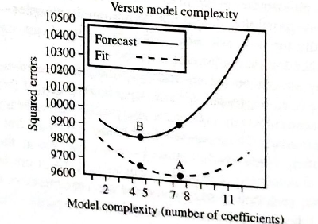
Trade-off: Errors Vs Complexity
Q-How to choose a model that forecasts accurately?
Consider the graph in the fig:
Importance of principle of Parsimony

Slide 3
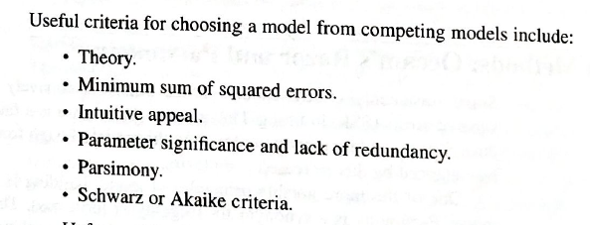
Choosing a Model: Options
Results could be conflicting – good option is to look at AIC/ BIC

Slide 4


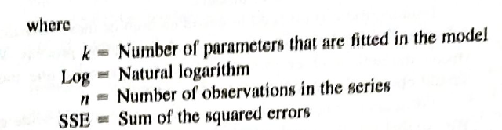
AIC/ BIC
Assist select models that trade off model complexity Vs Error in fitting, so as to achieve the most out of sample forecasts.
Select the lowest AIC/ BIC
BIC outperforms AIC in general forecasting

Slide 5
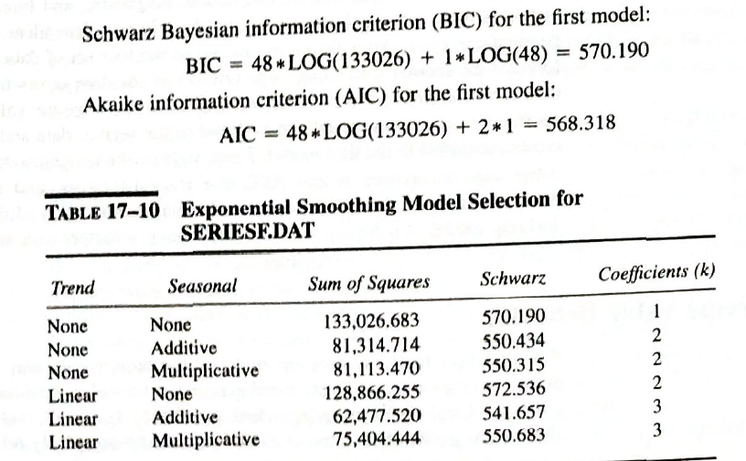
AIC/ BIC

Slide 6
Choose BIC over AIC
BIC penalizes model complexity more than AIC (hence perhaps the improved out-of-sample performance)
NB: We cannot compare them
Series to series
Or AIC to BIC
Choosing one model to another
Choose the model with the lowest BIC

Slide 7
Thank You

